Slide 1



IBM AICTE PROJECT
Nutrition Agent
Presented By:
Student name : ENDAPALLY RANITHREDDY
College Name : MALLA REDDY COLLLEGE OF ENGINEERING
AND TECHNOLOGY
Department : COMPUTER SCIENCE AND ENGINEERING

Slide 2
OUTLINE:-
Problem Statement
Technology used
Wow factor
End users
Result
Conclusion
Future scope
Git-hub Link
IBM Certifications

Slide 3
Problem Statement:-
In an era where health awareness is growing, individuals increasingly seek personalized nutrition guidance. However, most existing tools provide generic diet plans, lack real-time adaptability, and fail to consider a person's holistic lifestyle, cultural preferences, allergies, and evolving health conditions. Furthermore, dieticians and nutritionists face limitations in scaling personalized consultations due to time and resource constraints.
Generative AI presents a groundbreaking opportunity to revolutionize this space by enabling an intelligent, interactive, and adaptive virtual nutrition assistant. By leveraging natural language processing (NLP), multimodal understanding, and large-scale dietary databases, an AI-powered assistant can generate dynamic meal plans, recommend smart food swaps, and explain nutritional choices—all tailored to the individual.
This project aims to develop “The Smartest AI Nutrition Assistant” using state-of-the-art generative AI models that:
Understand user inputs via text, voice, or image (e.g., food photos, grocery labels)
Generate personalized meal plans based on health goals, medical conditions, fitness routines, and preferences
Offer contextual explanations (e.g., “Why is this food better?”)
Adapt suggestions dynamically with continuous feedback
By integrating health data, food databases, and LLM-powered reasoning, the solution will bridge the gap between one-size-fits-all diet apps and in-person nutrition counselling—delivering an AI that thinks, learns, and cares like a real nutrition expert.

Slide 4

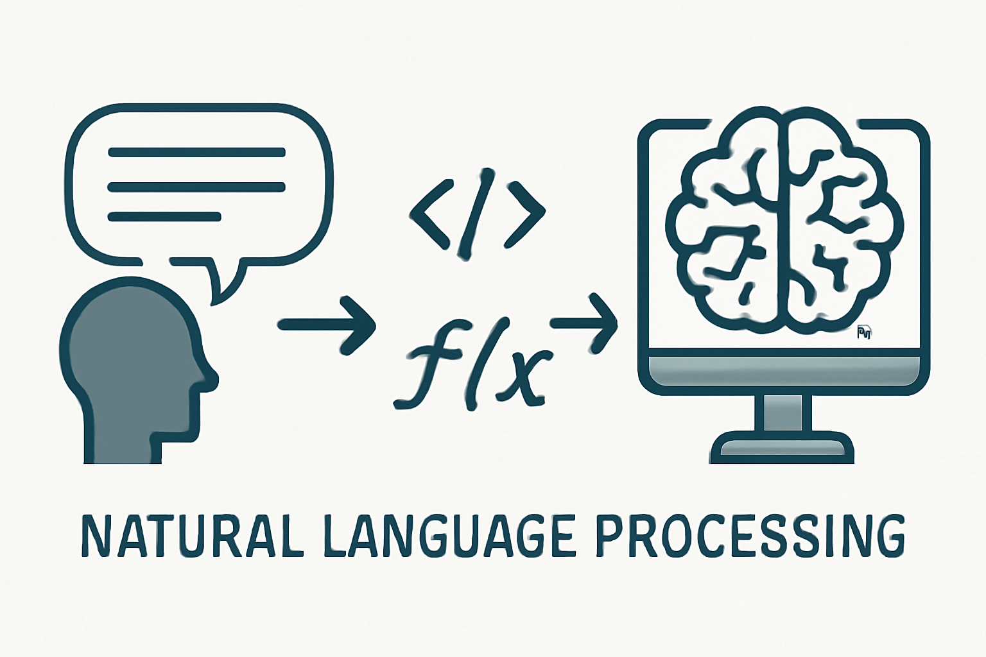
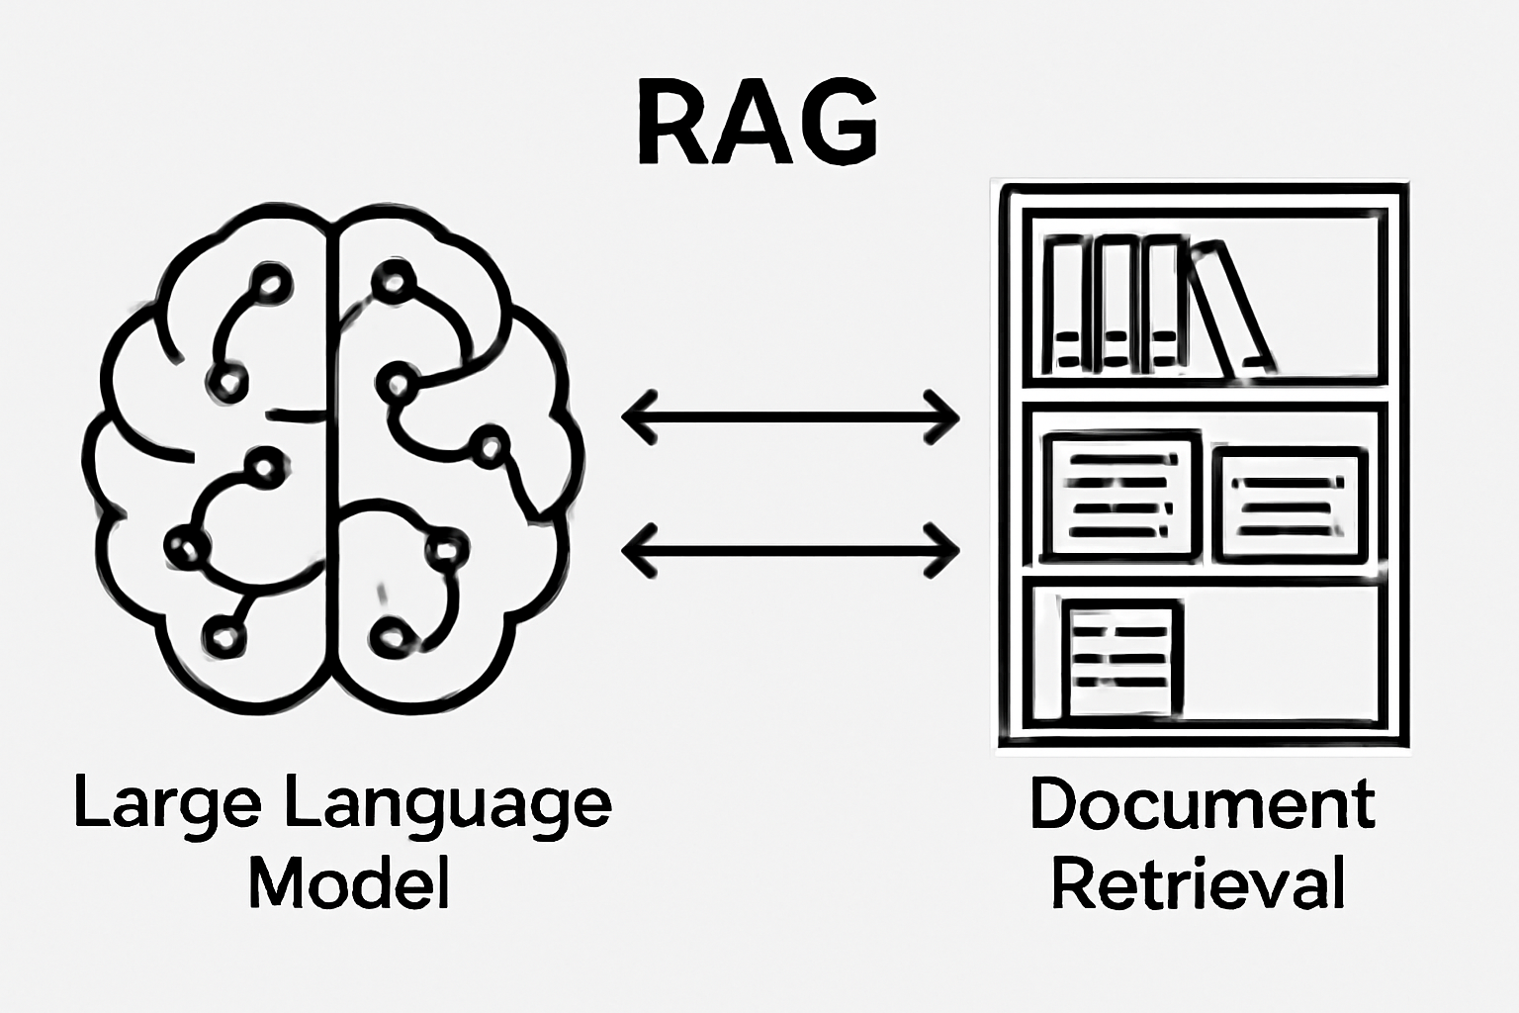
Technology used:-
IBM cloud lite services:-IBM Cloud Lite services offer free, always-available access to select cloud tools and APIs, ideal for learning and prototyping without incurring any costs.
Natural Language Processing (NLP):-NLP is a field of artificial intelligence that equips computers to understand, interpret, and generate human language, enabling natural interactions between machines and people.
Retrieval Augmented Generation (RAG):-RAG combines large language models with external information retrieval, allowing the model to fetch relevant data from documents or databases and generate accurate, up-to-date responses.

Slide 5
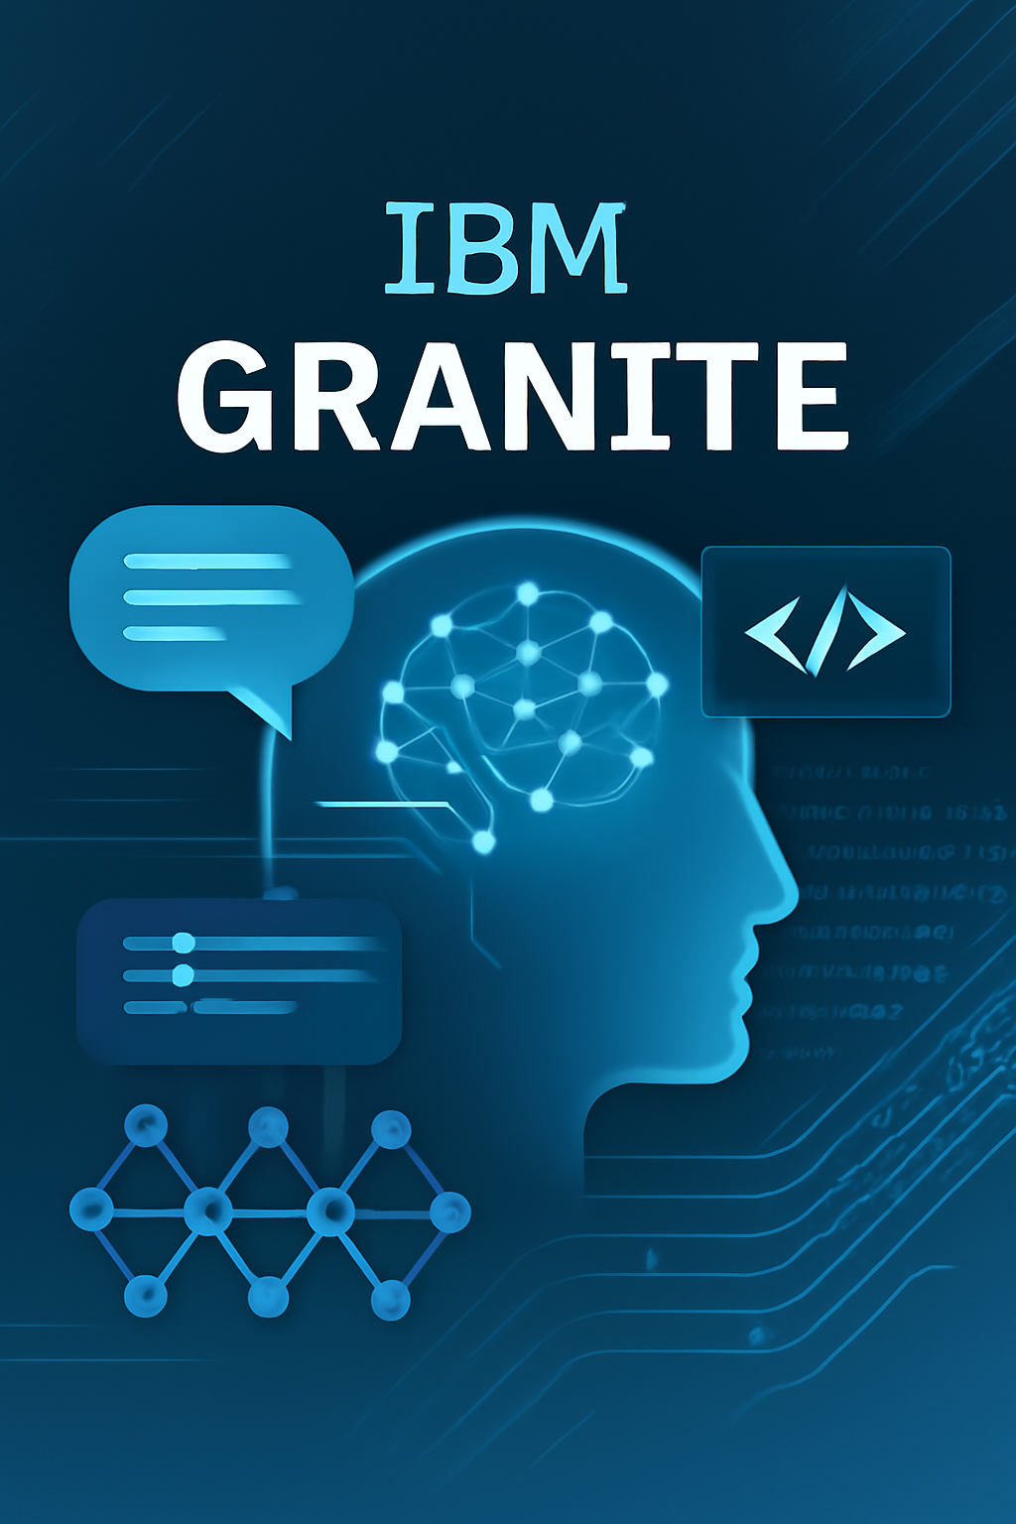

IBM Granite model:-IBM Granite is a series of enterprise-ready, open-source large language models designed for generative AI tasks with a special focus on transparency, efficiency, and support for both language and code applications.
IBM Cloud Object Storage:-IBM Cloud Object Storage is a secure, scalable service for storing and managing unstructured data like documents, images, and backups, accessible via REST APIs and suitable for cloud and hybrid deployments

Slide 6

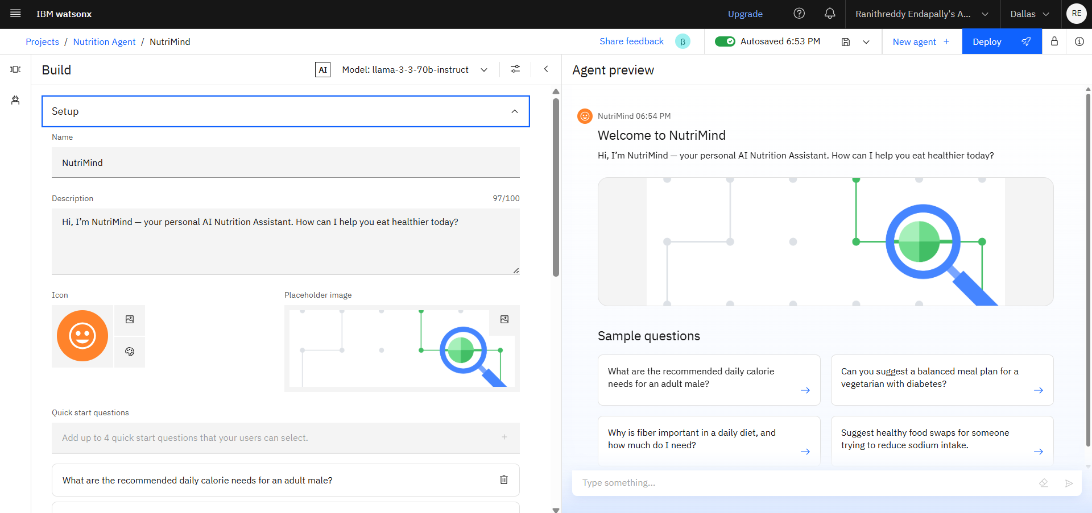
IBM cloud services used:-
IBM Cloud Watsonx AI Studio: An integrated, collaborative environment featuring robust tools to build, train, and manage generative AI and machine learning models, supporting both code-based and no-code workflows for all skill levels.
IBM Cloud Watsonx AI Runtime: Provides the computing resources and runtime services necessary for training, deploying, and running AI models developed in Watsonx Studio, including support for autoML and foundation model inferencing.
IBM Cloud Agent Lab: A low-code interface within Watsonx AI that enables developers to create, configure, and deploy AI agents capable of automating complex tasks using large language models—with minimal coding.

Slide 7
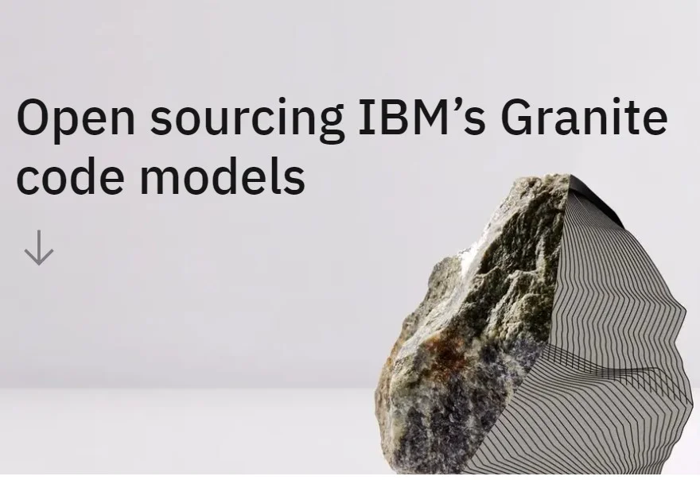
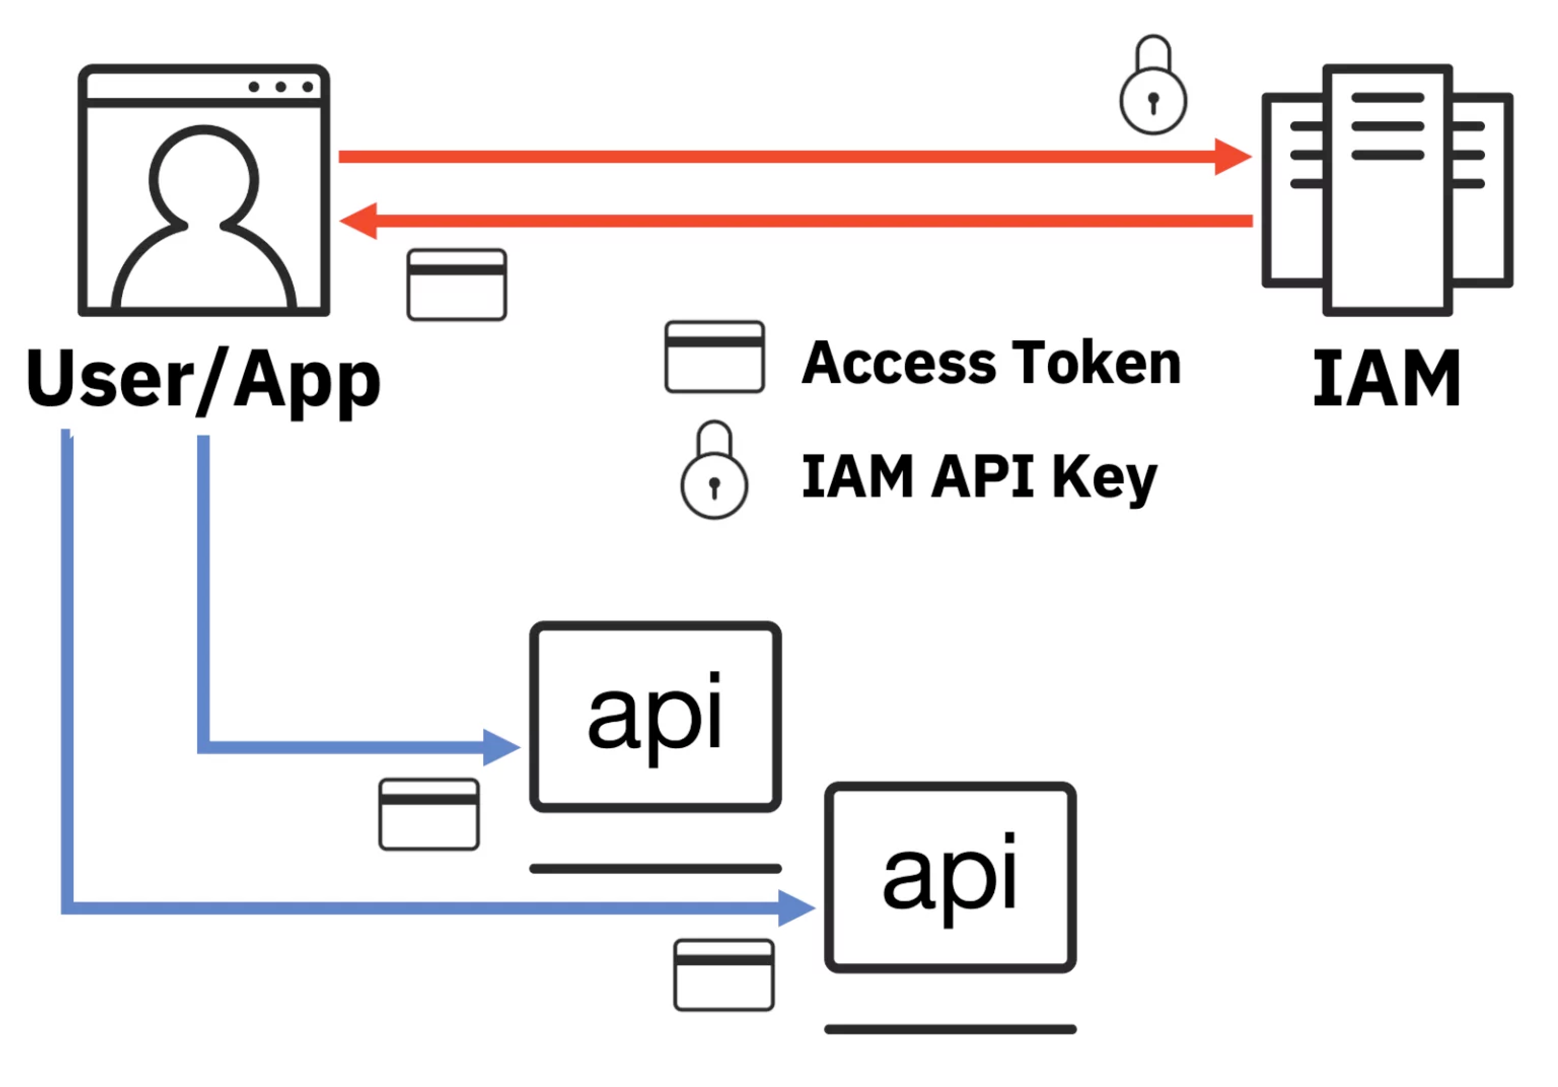
IBM Granite Foundation Model: A family of open-source, enterprise-focused large language models created by IBM, designed for generative AI applications that require transparency, security, and adaptability for language and code tasks
IBM Cloud IAM (Identity and Access Management): The security framework that allows you to authenticate users and authorize access to IBM Cloud resources through centralized policies, supporting users, service identities, and access groups

Slide 8
Wow factors:-
This intelligent assistant is designed to dramatically cut down the time spent on research, enhance the depth and quality of literature reviews, and guide early-stage researchers in finding relevant academic paths. It also encourages cross-disciplinary collaboration by transforming complex knowledge into more accessible and actionable insights.
Key Features:
Semantic search capability across academic journals, datasets, and research papers
Automatic summarization of selected documents
Citation tracking and reference mapping to understand research influence
Paper recommendations tailored to a user's current research focus
Keyword-based trend analysis across time and domains
Discovery of potential collaborators or institutions based on shared research themes

Slide 9
End users:-
Individuals & General Public: Services and solutions aimed at empowering everyday people to make informed decisions and improve their lifestyles.
Healthcare & Wellness Professionals: Tools and technologies tailored for medical experts to enhance patient care, diagnostics, and wellness programs.
Education & Institutions: Resources designed to support schools, colleges, and educational bodies in delivering quality learning experiences and efficient administration.
Corporates & Food Services: Solutions that help businesses and food service providers optimize operations, ensure compliance, and deliver value to customers.
Retail & Food Industry: Innovations for retailers and food producers to enhance supply chains, product offerings, and customer engagement.
Government & NGOs: Systems and platforms that assist governmental and non-governmental organizations in public service delivery, policy enforcement, and community development.

Slide 10
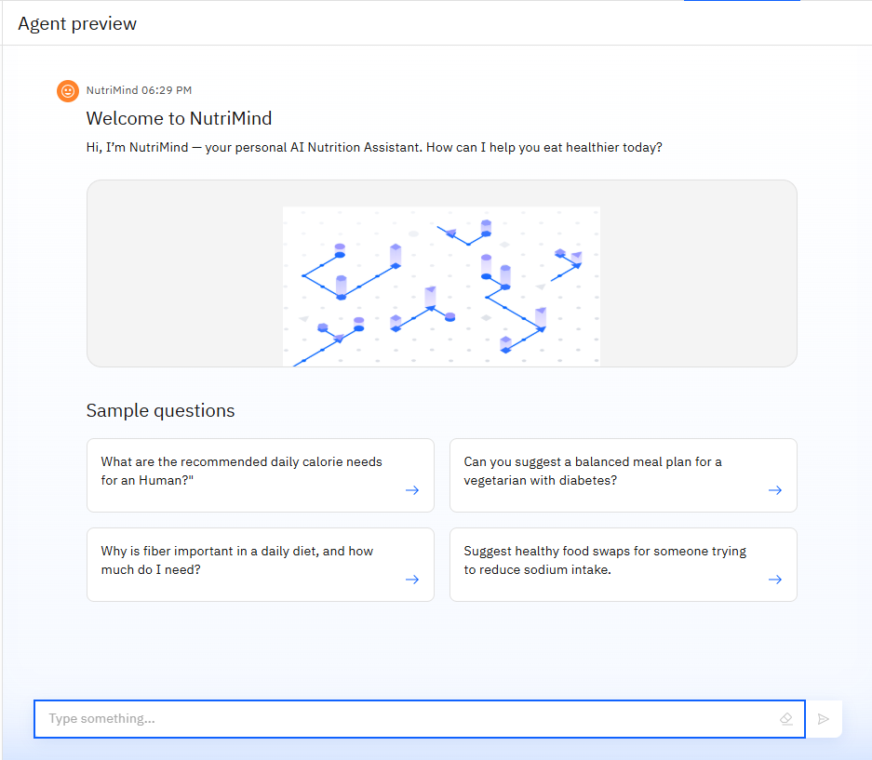
Results
This image showcases the final preview of the deployed NutriMind agent, developed using IBM Watsonx.ai and associated IBM Cloud technologies. The AI interface is capable of understanding and responding to user queries related to nutrition in real-time.
Suggested sample questions that demonstrate the agent's ability to:
Recommend calorie needs.
Create custom meal plans (e.g., for diabetics or vegetarians).
Explain nutritional concepts (e.g., fiber importance).
Provide healthy food swaps.

Slide 11
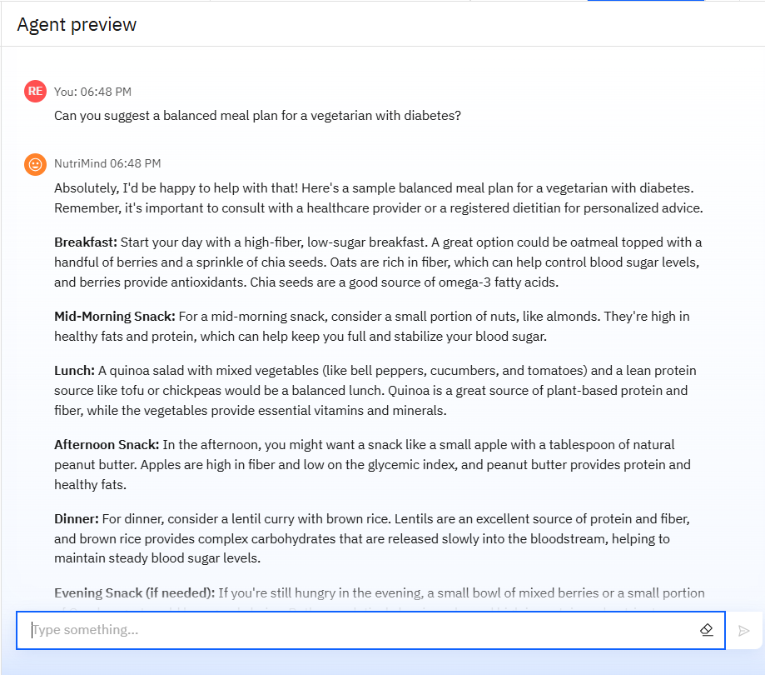
Results

Slide 12
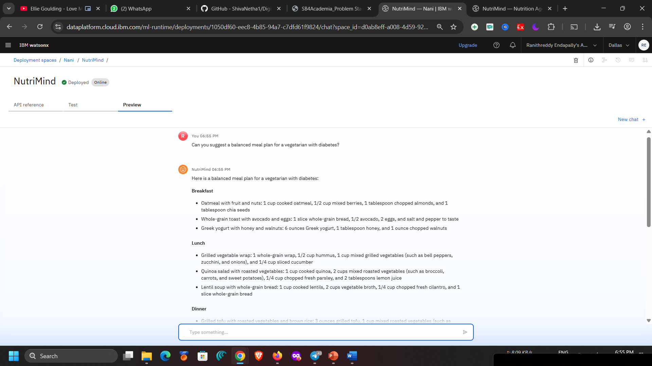
Results
Deployed AI Agent
This image displays the deployed version of the NutriMind AI Nutrition Agent running live in the IBM Cloud environment. After successful training and configuration using IBM Watsonx.ai, the agent is now able to provide real-time, personalized responses to nutrition-related queries.
In this instance, the user asked for a balanced meal plan for a vegetarian with diabetes, and the agent generated a detailed, structured response with meal suggestions categorized by time of day (e.g., breakfast, lunch, dinner). This demonstrates the agent's ability to combine retrieval-augmented generation (RAG) with user context to deliver custom health advice at scale.

Slide 13
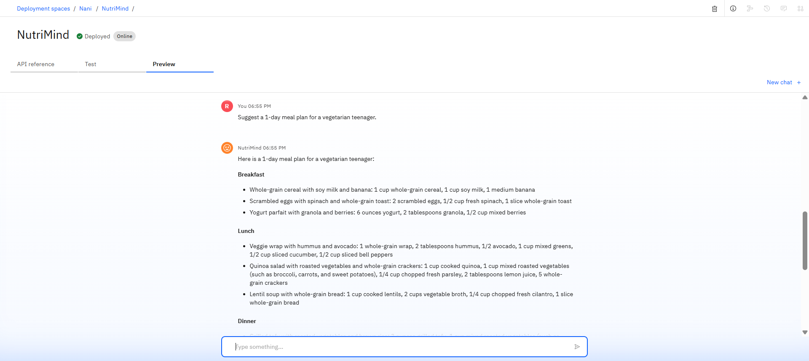
Results
Deployed AI Agent

Slide 14
Conclusion:-
NutriMind showcases the potential of AI-powered assistants to revolutionize how individuals approach nutrition and dietary planning. By leveraging generative AI and IBM Watsonx, the agent can dynamically generate personalized meal plans, explain nutritional choices, and adapt to user preferences and health goals.
Beyond basic queries, NutriMind can support decision-making by offering data-backed suggestions, interpreting dietary guidelines, and simplifying complex health information. This eliminates the need for manual research and streamlines access to credible nutrition advice.
Ultimately, the AI Nutrition Agent enhances health literacy, saves time, and empowers users to make smarter food choices—bridging the gap between generic diet apps and personalized expert consultation.

Slide 15
Future scope:-
Voice-Activated Nutrition Assistant
Real-Time Diet Tracking & Feedback
Personalized Recipe Generation
Disease-Specific Nutrition Coaching
Integration with Telehealth Platforms
Emotion-Aware Food Suggestions

Slide 16
GitHub Link
https://github.com/ranithreddy/AI-Nutrition-Assistant-Using-IBM-Cloud/tree/main

Slide 17
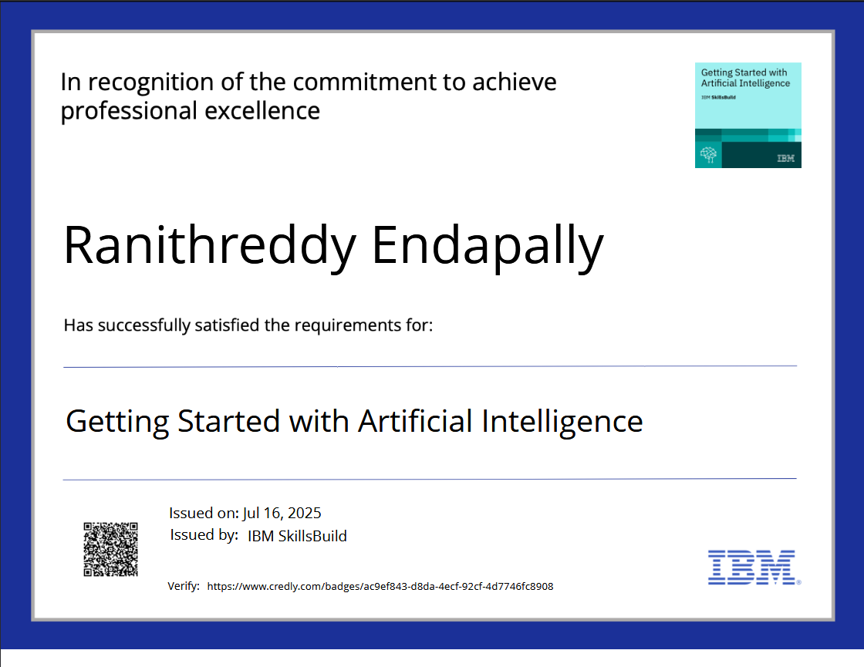
IBM Certifications:- Getting Started with Artificial Intelligence

Slide 18
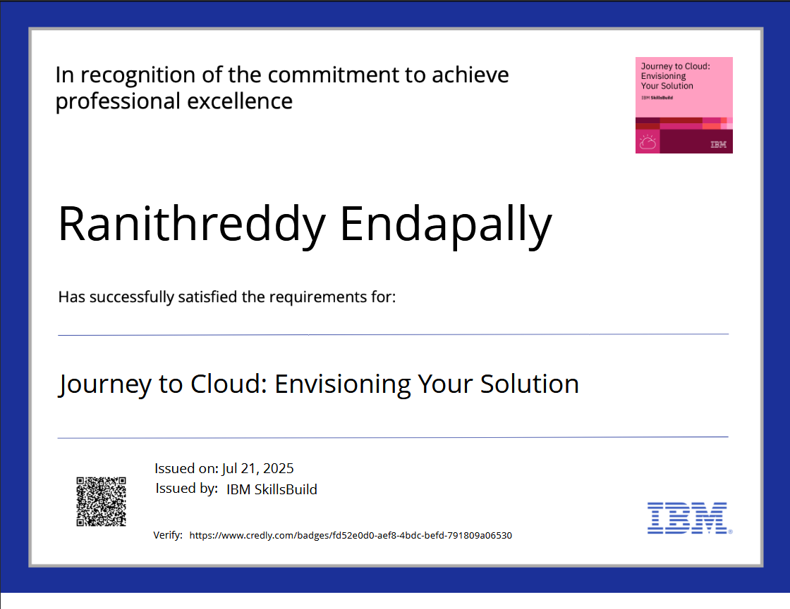
Journey to Cloud: Envisioning Your Solution

Slide 19
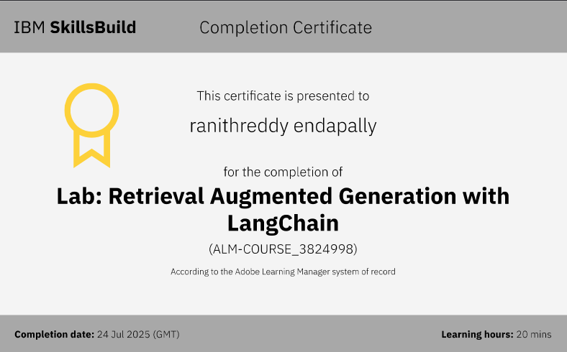
Retrieval Augmented Generation

Slide 20
THANK YOU

